Slide 1
- Understanding Diffusion Models:
A Unified Perspective
2023.05.03
Jong Jun Won

Slide 2
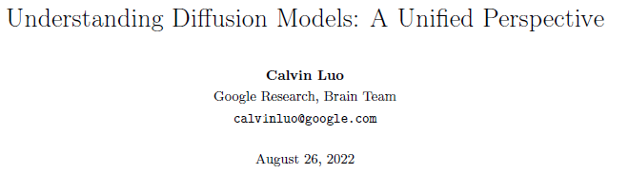
Preprint

Slide 3
0. contents
1. Introduction : Generative Models
2. Background – ELBO, VAE, Hierachical VAE
3. Variational Diffusion Models
4. Three equivalent Interpretations

Slide 4
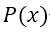
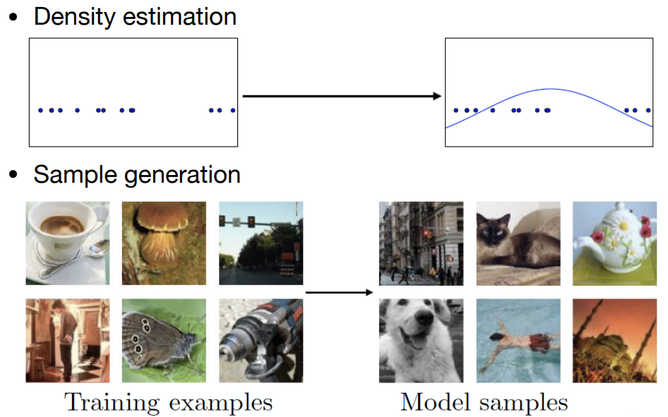
1. Introduction
Generative Models
Given observed samples x, the goal is to learn to model its true data distribution
Data distribution : the statistical characteristics and patterns present in the real data
It specifies the probabilities of all events – Introduction to probability
Once learned, we can generate new samples from our approximate model.
GAN
Likelihood-based : Variational Autoencoders

Slide 5
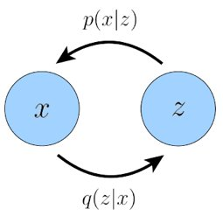
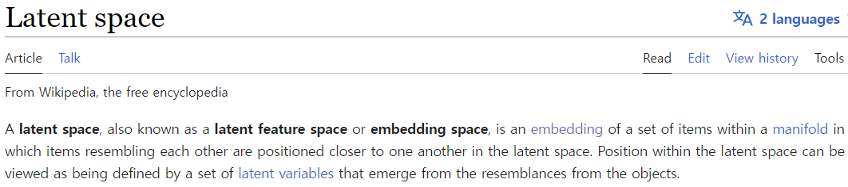
2. Background
Latent variable
We can think of The data(X) as generated by an associated unseen latent variable(Z).
We generally seek to learn latent representations (low-dimension) rather than higher-dimensional ones.
Learning data distribution in lower-dimension is more easier than high-dimension (sparsity, complexity)
Learning lower-dimensional latents can also be seen as a form of compression
The best intuition for expressing this idea is through Plato’s Allegory of the Cave.

Slide 6
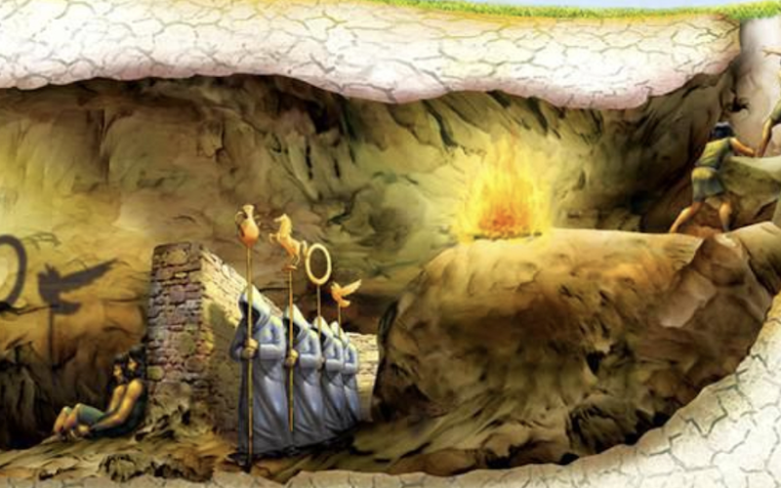
2. Background
Latent variable
the two(low) dimensional
Unseen three(high) dimension
(Generated) Object : encapsulate abstract properties (size, shape, and more)
Z
X
The cave people can never see the hidden objects
They can still reason and draw(generate) inferences about them.
In a similar way, we can approximate latent representations that describe the data we observe.
1. Feature Extraction, Compression from dataset (X -> Z)
2. Generation from latent variable (Z -> X)

Slide 7
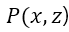
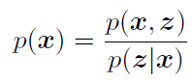
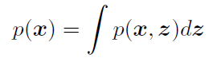
2. Background
Evidence Lower Bound
Likelihood-based : to learn a model to maximize the likelihood p(x)
The latent variables and the data as modeled by a joint distribution

Slide 8
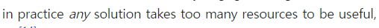
2. Background
Evidence Lower Bound
maximizing the likelihood p(x) is difficult because it either involves integrating out all latent variables z,
which is intractable for complex models,
it involves having access to a ground truth latent encoder p(z|x)

Slide 9
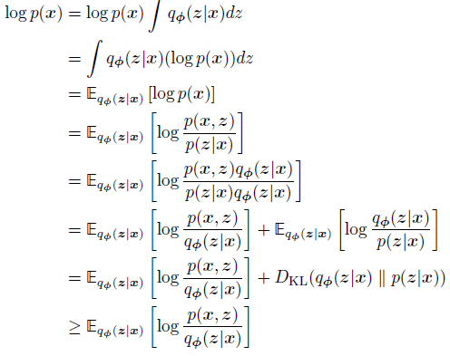
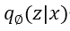
2. Background
Evidence Lower Bound
: a parameterizable model that is learned to
estimate the true distribution over latent variables
for given x

Slide 10
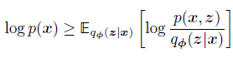

2. Background
Evidence Lower Bound
the Evidence Lower BOund (ELBO) is a lower bound of the log likelihood of (the evidence).
Then, maximizing the ELBO becomes a proxy objective with which to optimize a latent variable model
q_pi(z|x) : parameters pi that we seek to optimize true latent variables for given observations x
Our goal is to learn this underlying latent structure that describes our observed data
approximation

Slide 11
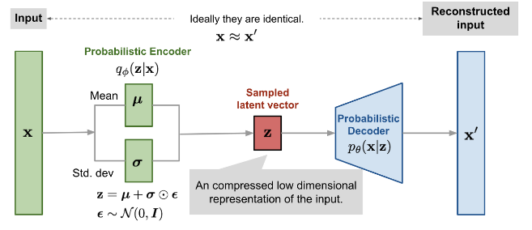
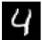
2. Background
Variational Autoencoder

Slide 12
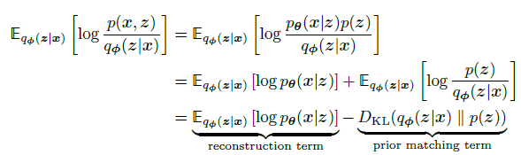
2. Background
Variational Autoencoder
The ELBO is optimized jointly over parameters and .

Slide 13
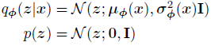
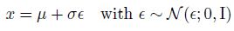
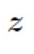
2. Background
Variational Autoencoder
The encoder : a multivariate Gaussian with diagonal covariance
The latent : a standard multivariate Gaussian
Dot product

Slide 14
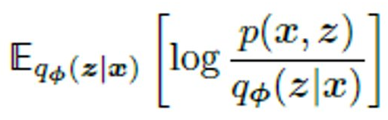
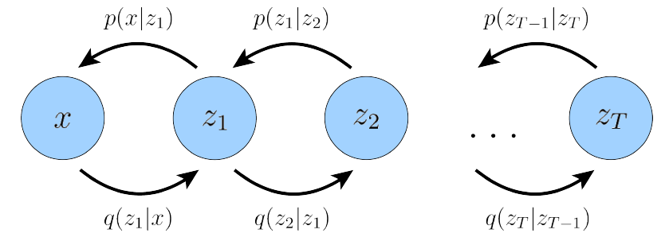
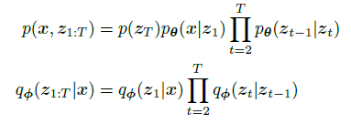
2. Background
Hierachical Variational Autoencoder
A Hierarchical Variational Autoencoder (HAVE) is a generalization of a VAE that extends to multiple hierachies over latent variables.
Markovian HVAE
In a MHVAE, the generative process is a Markov chain,
Each latent Zt is generated only from the previous latent.

Slide 15
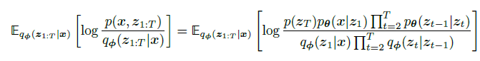
2. Background
Hierachical Variational Autoencoder

Slide 16
3. Variational Diffusion Models
VDM is as a Markovian HVAE with three key restrictions

Slide 17
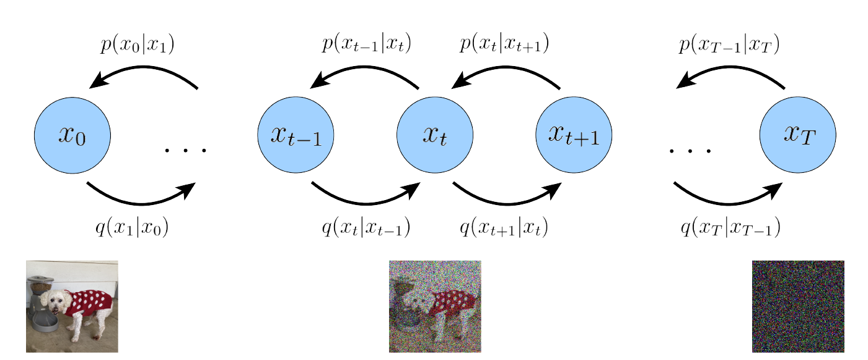
3. Variational Diffusion Models
First, The latent dimension is exactly equal to the data dimension
512*512
512*512
512*512
512*512

Slide 18
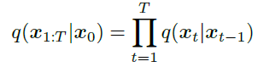
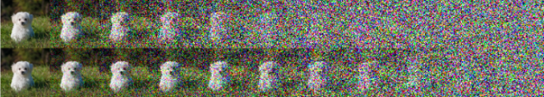
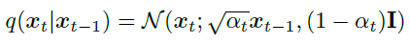
3. Variational Diffusion Models
Second, The structure of the latent encoder at each timestep is not learned
it is pre-defined as a linear Gaussian model.
It is a Gaussian distribution centered around the output of the previous timestep.
Jj is coefficient that can vary with the hierachical depth t
Signal to noise ratio(SNR) must monotonically decrease over time

Slide 19
3. Variational Diffusion Models
Third, The Gaussian parameters of the latent encoders vary over time
In such a way that the distribution of the latent at final timestep T is a standard Gaussian

Slide 20
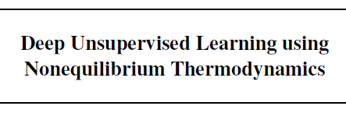
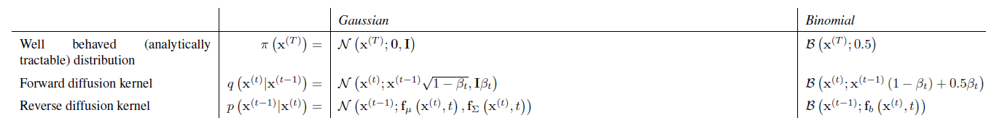
#. HOW Diffusion, WHY Gaussian?
Refered From
inspired by non-equilibrium statistical physics, is to systematically and slowly destroy structure in a data distribution through an iterative forward diffusion process.
We then learn a reverse diffusion process that restores structure in data, yielding a highly flexible and tractable generative model of the data

Slide 21
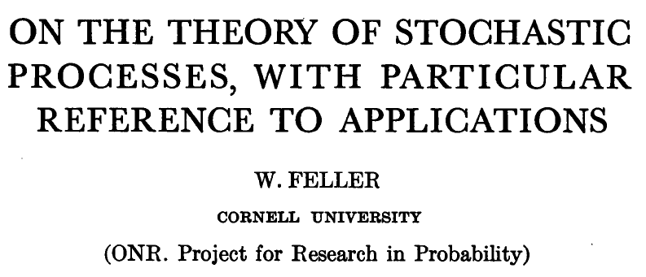
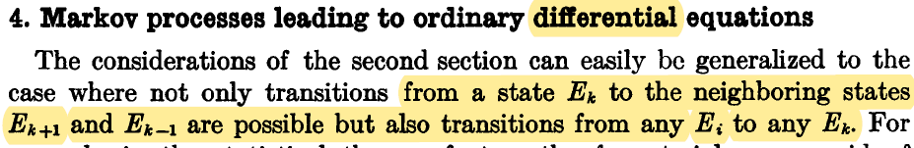
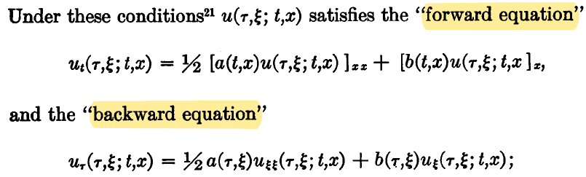
#. HOW Diffusion, WHY Gaussian?
Refered From
HOW?
Markov process : differential
Forward, Backward의 확률 분포가 같다.
-> 원본 분포의 추정이 가능하다.

Slide 22
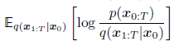
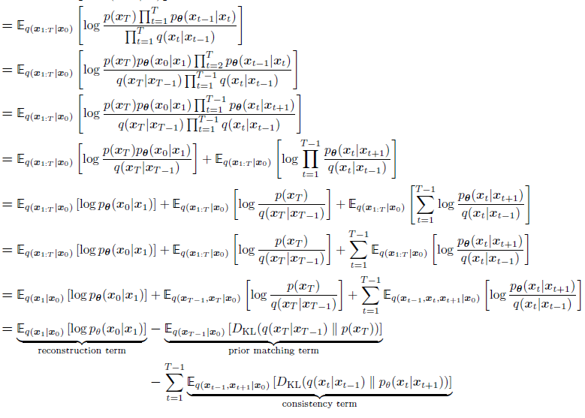
3. Variational Diffusion Models
Basic Formula

Slide 23
3. Variational Diffusion Models
Basic Formula

Slide 24
3. Variational Diffusion Models
Basic Formula
However, actually optimizing the ELBO using the terms we just derived might be suboptimal; because the consistency term is computed as an expectation over two random variables.
the variance of its Monte Carlo estimate could potentially be higher than a term that is estimated using only one random variable per timestep.
Let us try to derive a form for our ELBO where each term is coputed as an expectation over only one random variable at a time

Slide 25
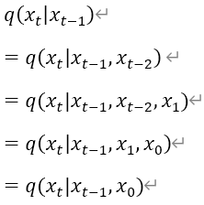
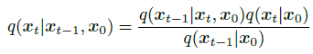
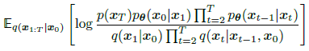
3. Variational Diffusion Models
Basic Formula
The key insight is that we can rewrite encoder transitions

Slide 26
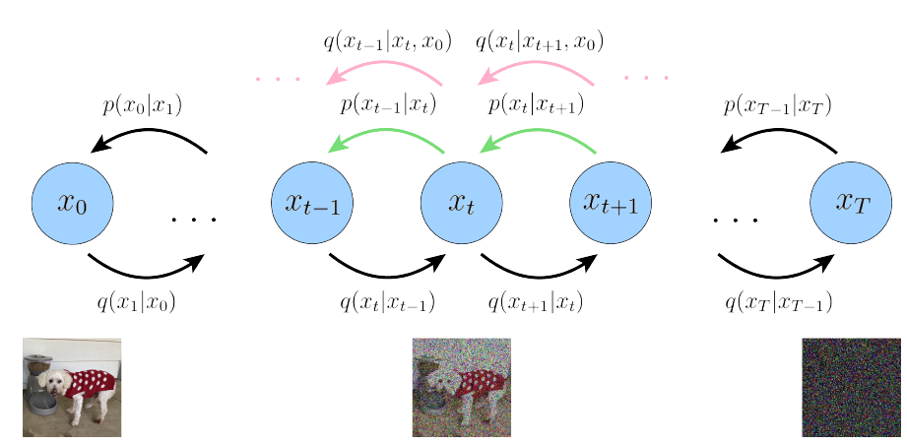
3. Variational Diffusion Models
Basic Formula

Slide 27
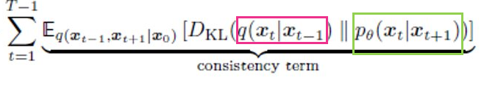
3. Variational Diffusion Models
Basic Formula
Denoising

Slide 28
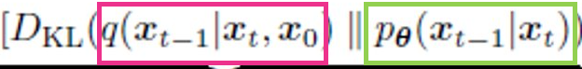
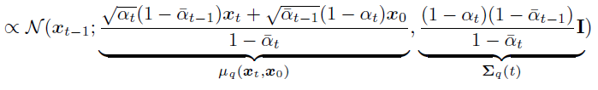
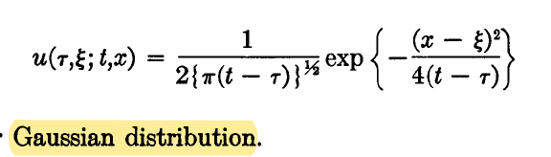
3. Variational Diffusion Models
Formula

Slide 29
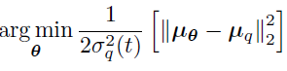
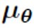
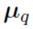
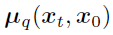
3. Variational Diffusion Models
Formula
as shorthand for
as shorthand for

Slide 30
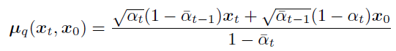
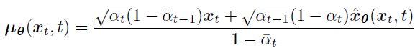
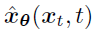
3. Variational Diffusion Models
Formula
as shorthand for
as shorthand for
is parameterized by a neural network that seeks to predict original image from noisy image and time index.

Slide 31
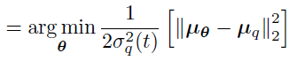

3. Variational Diffusion Models
Formula
as shorthand for
as shorthand for
is parameterized by a neural network that seeks to predict original image from noisy image and time index.
Optimizing VDM boils down to learning a neural network to predict the original ground truth image from an arbitrarily noisified version of it

Slide 32






4. Three equivalent Interpretations
Formula
is parameterized by a neural network that learns to predict the source noise
learning a VDM by predicting the original image is equivalent to learning to predict the noise

Slide 33



4. Three equivalent Interpretations
Formula

Slide 34





4. Three equivalent Interpretations
Formula
Mathematically, for a Gaussian variable
Tweedie's Formula states that :

Slide 35

5. Conclusion
Formula
Three equivalent objectives to optimize a VDM:
To predict the original image
To predict the source noise
To predict at an arbitrary noise level

